Slide 1
Abbey RotaKids 2023-24
Welcome to our new RotaKids.
President
Vice-President
Secretary
Publicity Manager
Treasurer

Slide 2



World Polio Day

Slide 3
-What is polio?
It is a serious infection that makes someone unable to move certain limbs, also called paralysis. It can also lead to trouble breathing and sometimes death now very rare because of the vaccination programme.
Rotary have worked incredibly hard to support the worldwide vaccination programme and after 35 years of hard work it is now only found in a few countries and the chance of getting it in the U.K is very low.
Right now Polio remains in only two countries, Pakistan and Afghanistan

Slide 4
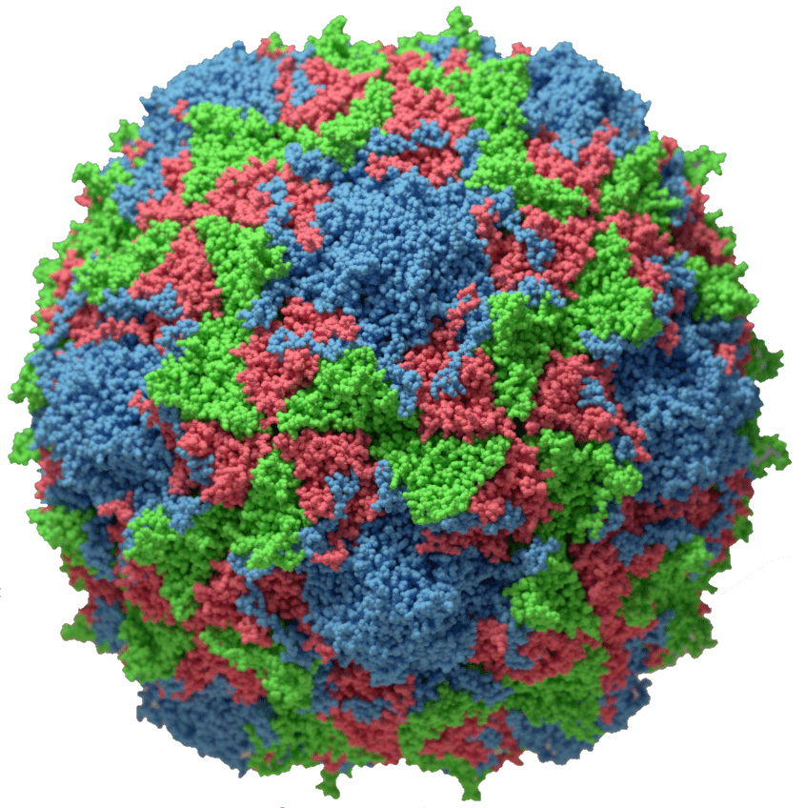
When was polio first discovered?
It was first found in 1789 by an English Doctor called Michael Underwood and was later found that it was a terrible sickness by a German physician Jakob Heine.
POLIO UNDER MICROSCOPE

Slide 5
World Polio Day 2023
Every year, there is a World Polio Day on the 24th October which raises awareness about the risk of polio and celebrates the success of the vaccination programme.
This year, on Friday 27th October, the Abbey RotaKids would like you to wear one item of purple clothing or accessories or paint your pinkie purple or you can do all three.
Why purple?
When a child is given their Polio vaccination by a Rotarian they mark their pinkies with a purple dye to show that they have been vaccinated.

Slide 6

